Slide 1
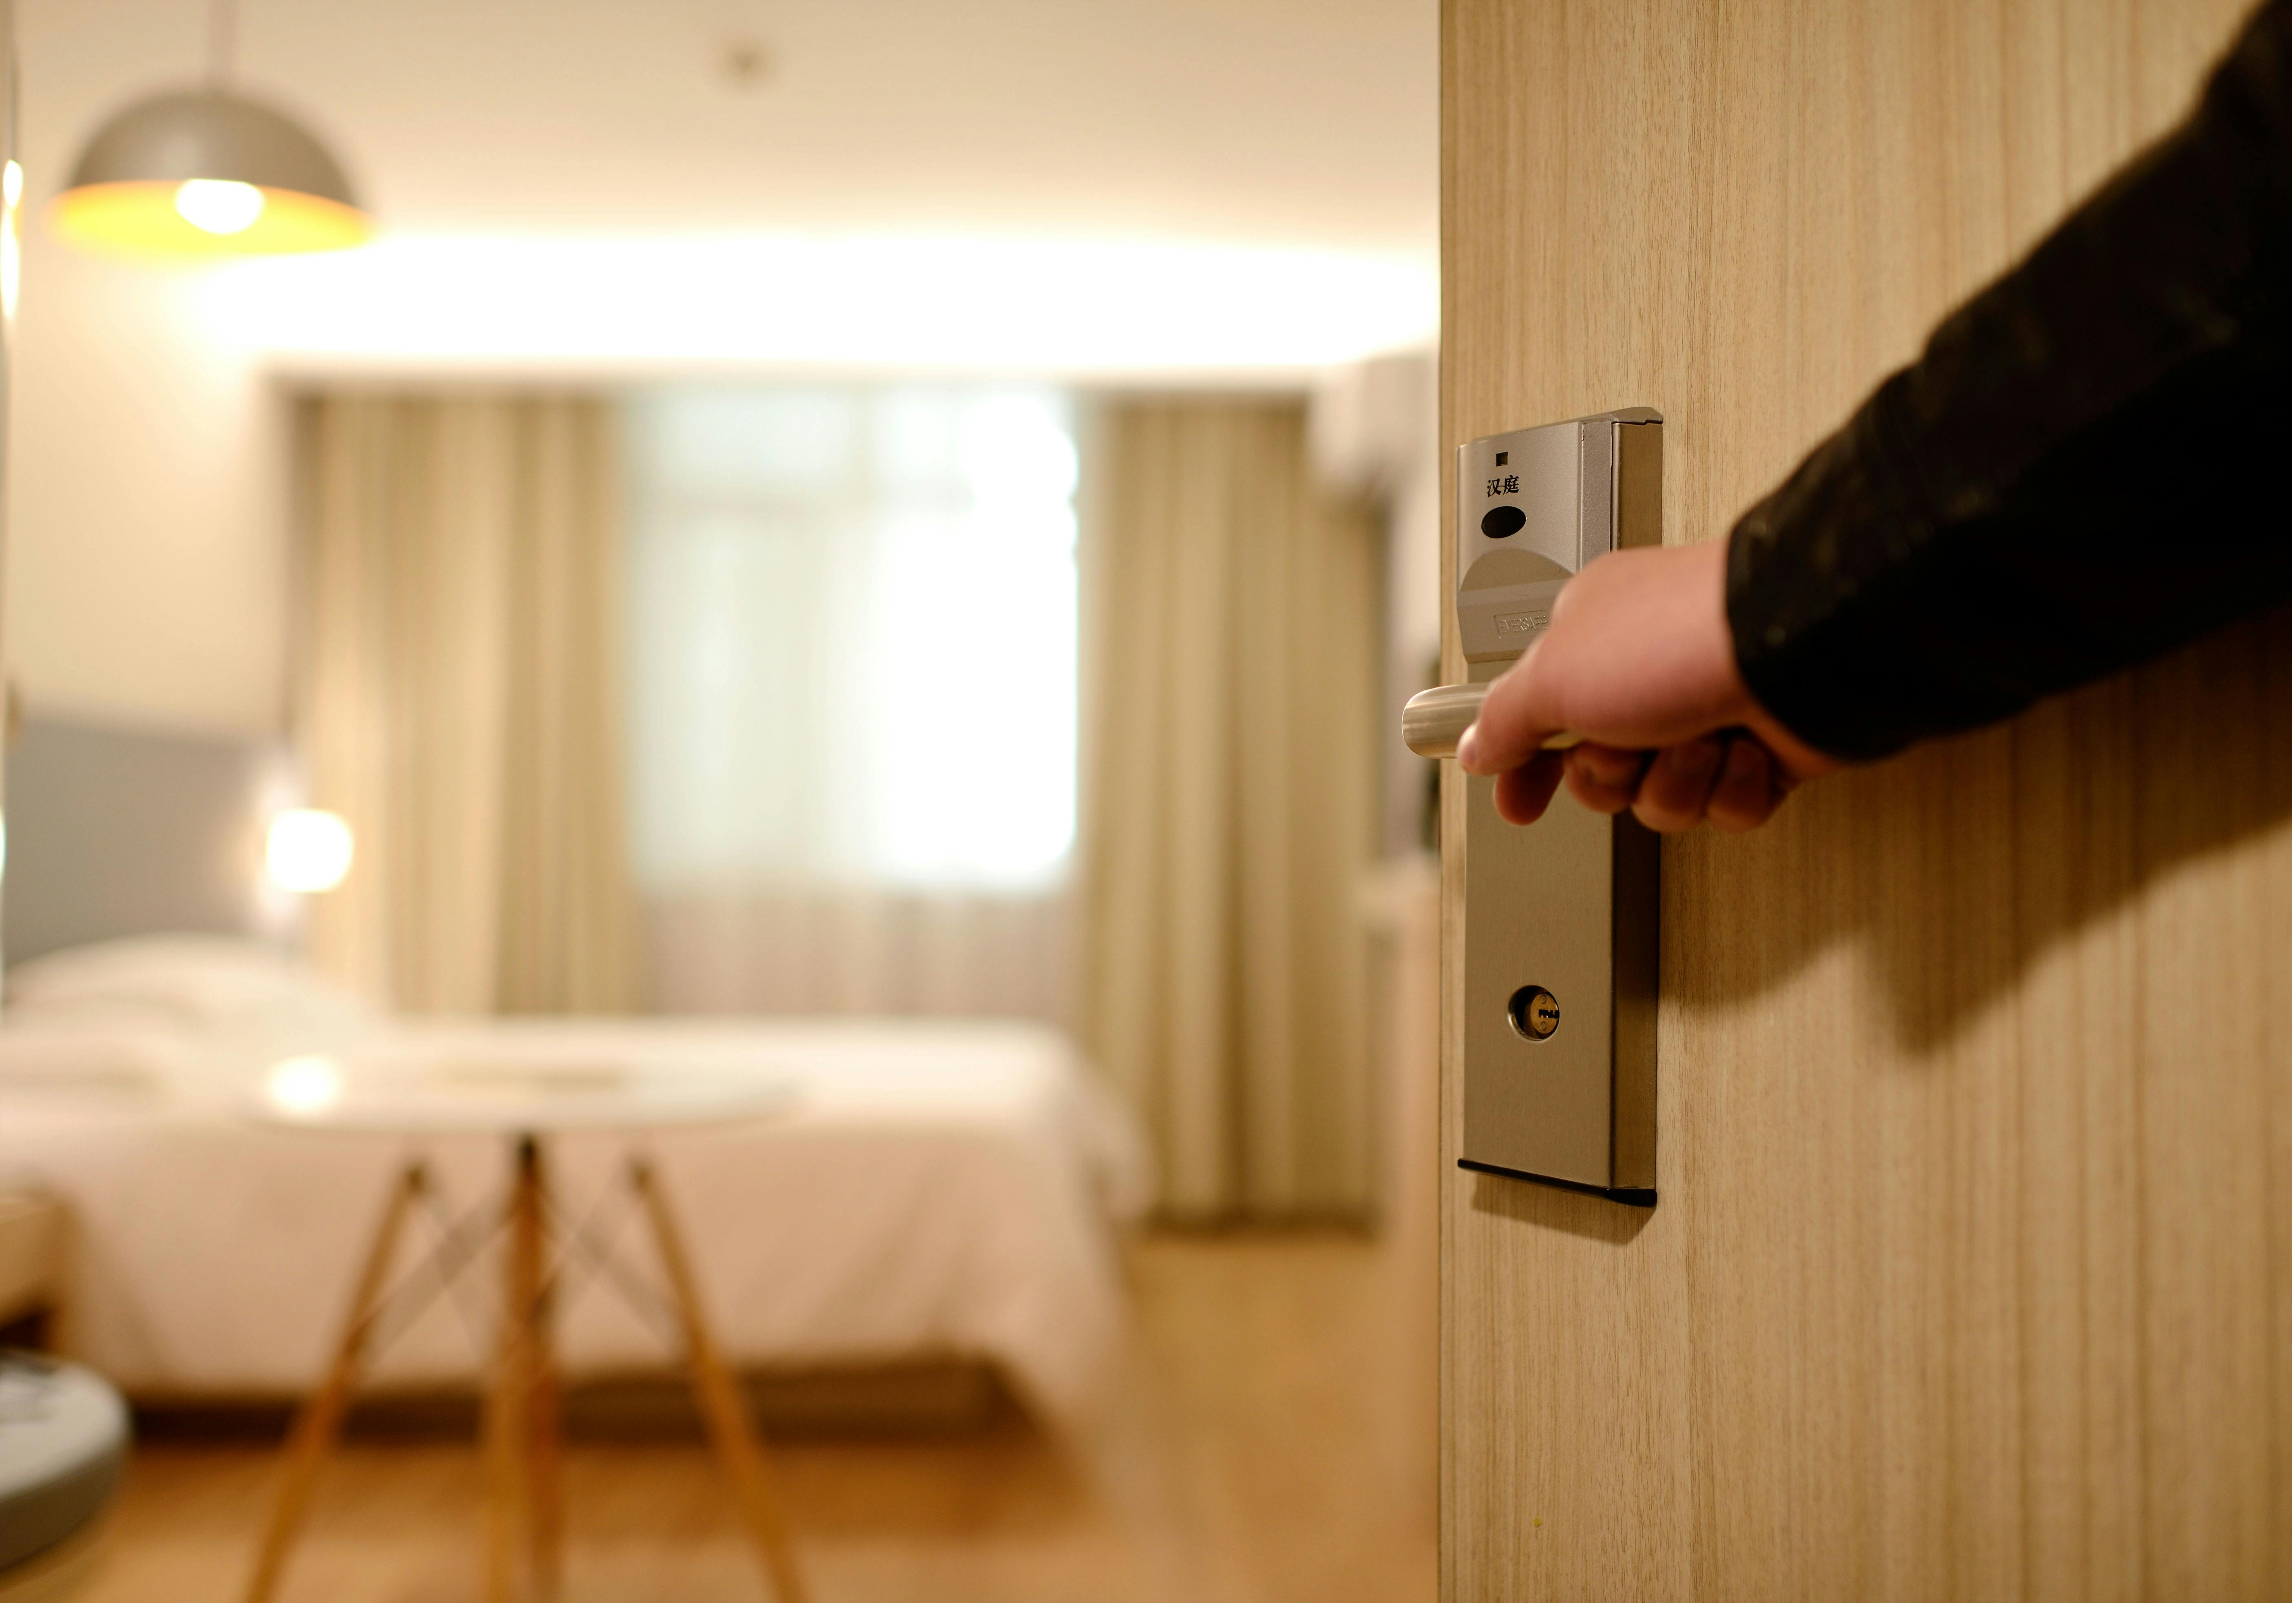
AtliQ Grands
AtliQ Grands
Bangalore
Delhi
Hyderabad
mumbai

Slide 2
AtliQ Grands
Bangalore
Delhi
Hyderabad
Mumbai

Slide 3
Provided Datasets
1. Dim_date
2. Dim_hotels
3. Dim_rooms 4.Fact_aggregated_bookings
5. Fact_bookings
Metrics List
Mockup Dashboard

Slide 4
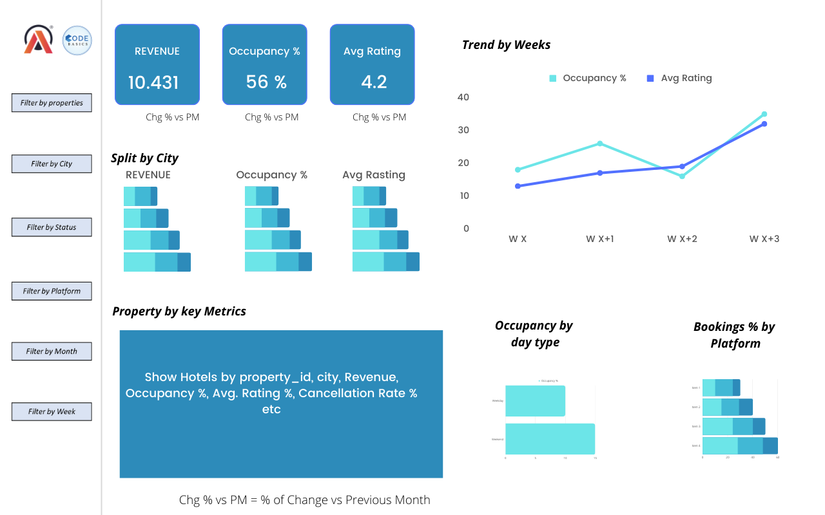
Mockup Dashboard

Slide 5
Tasks
Create the metrics according to the metric list.
Create a dashboard according to the mock-up provided by stakeholders.
Create relevant insights that are not provided in the metric list/mock-up dashboard

Slide 6
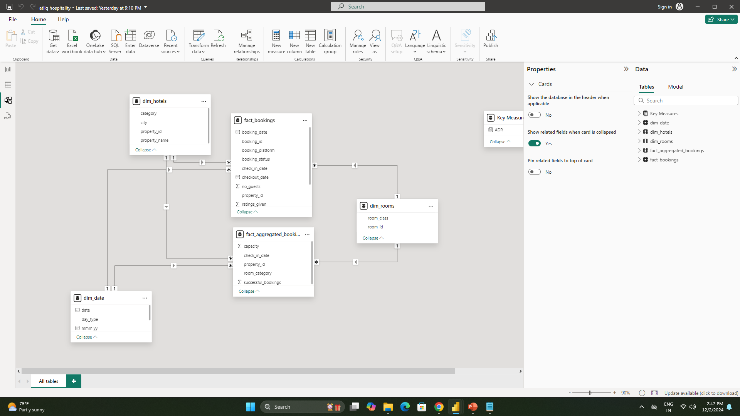
Data Model

Slide 7
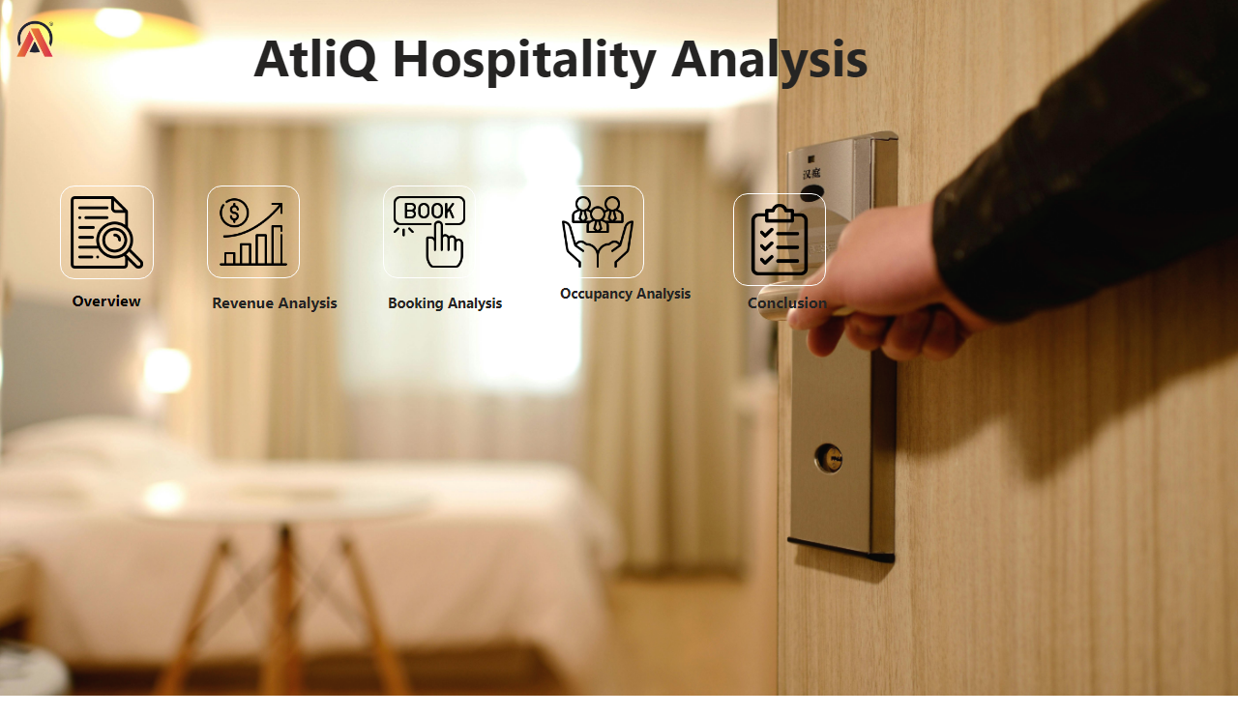
Home
Notes:
image
No alt text provided
image
No alt text provided
image
No alt text provided
image
No alt text provided
image
No alt text provided
image
No alt text provided
textbox
No alt text provided
textbox
No alt text provided
textbox
No alt text provided
textbox
No alt text provided
textbox
No alt text provided
textbox
No alt text provided

Slide 8
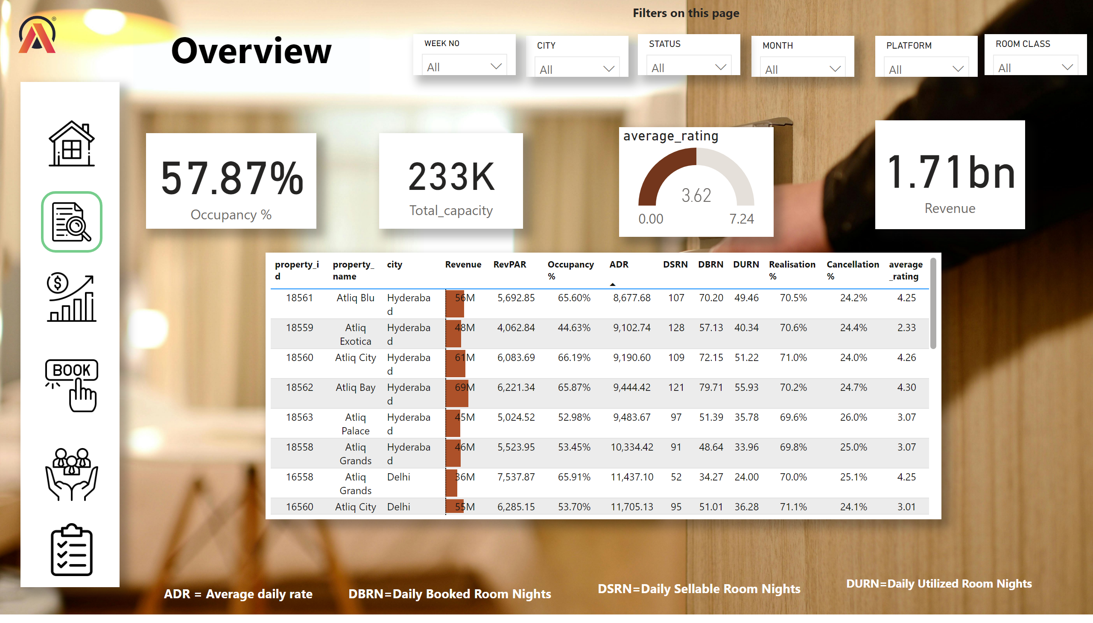
Overview
Notes:
tableEx
No alt text provided
card
No alt text provided
card
No alt text provided
gauge
No alt text provided
image
No alt text provided
card
No alt text provided
image
No alt text provided
image
No alt text provided
image
No alt text provided
image
No alt text provided
image
No alt text provided
image
No alt text provided
shape
No alt text provided
textbox
No alt text provided
slicer
No alt text provided
slicer
No alt text provided
slicer
No alt text provided
slicer
No alt text provided
slicer
No alt text provided
slicer
No alt text provided
textbox
No alt text provided
textbox
No alt text provided
textbox
No alt text provided
textbox
No alt text provided
textbox
No alt text provided

Slide 9
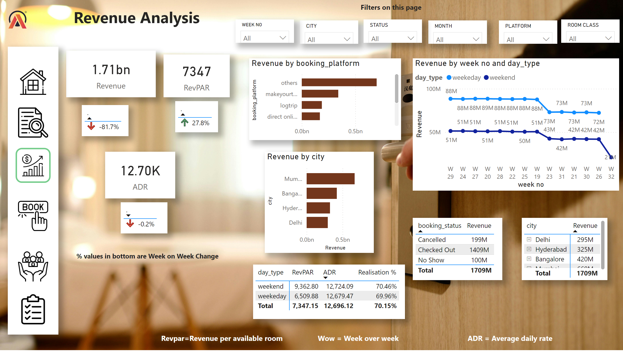
Revenue Analysis
Notes:
slicer
No alt text provided
slicer
No alt text provided
slicer
No alt text provided
slicer
No alt text provided
lineChart
No alt text provided
image
No alt text provided
tableEx
No alt text provided
card
No alt text provided
barChart
No alt text provided
barChart
No alt text provided
pivotTable
No alt text provided
card
No alt text provided
tableEx
No alt text provided
tableEx
No alt text provided
textbox
No alt text provided
textbox
No alt text provided
textbox
No alt text provided
slicer
No alt text provided
slicer
No alt text provided
card
No alt text provided
textbox
No alt text provided
pivotTable
No alt text provided
tableEx
No alt text provided
textbox
No alt text provided
textbox
No alt text provided
shape
No alt text provided
image
No alt text provided
image
No alt text provided
image
No alt text provided
image
No alt text provided
image
No alt text provided
image
No alt text provided

Slide 10
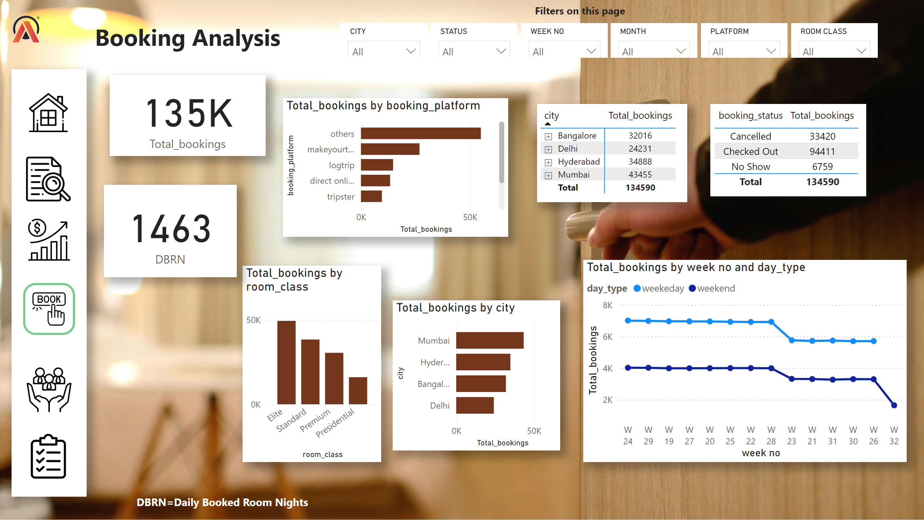
Booking Analysis
Notes:
lineChart
No alt text provided
image
No alt text provided
tableEx
No alt text provided
barChart
No alt text provided
columnChart
No alt text provided
barChart
No alt text provided
pivotTable
No alt text provided
textbox
No alt text provided
textbox
No alt text provided
card
No alt text provided
slicer
No alt text provided
slicer
No alt text provided
card
No alt text provided
slicer
No alt text provided
slicer
No alt text provided
slicer
No alt text provided
slicer
No alt text provided
textbox
No alt text provided
shape
No alt text provided
image
No alt text provided
image
No alt text provided
image
No alt text provided
image
No alt text provided
image
No alt text provided
image
No alt text provided

Slide 11
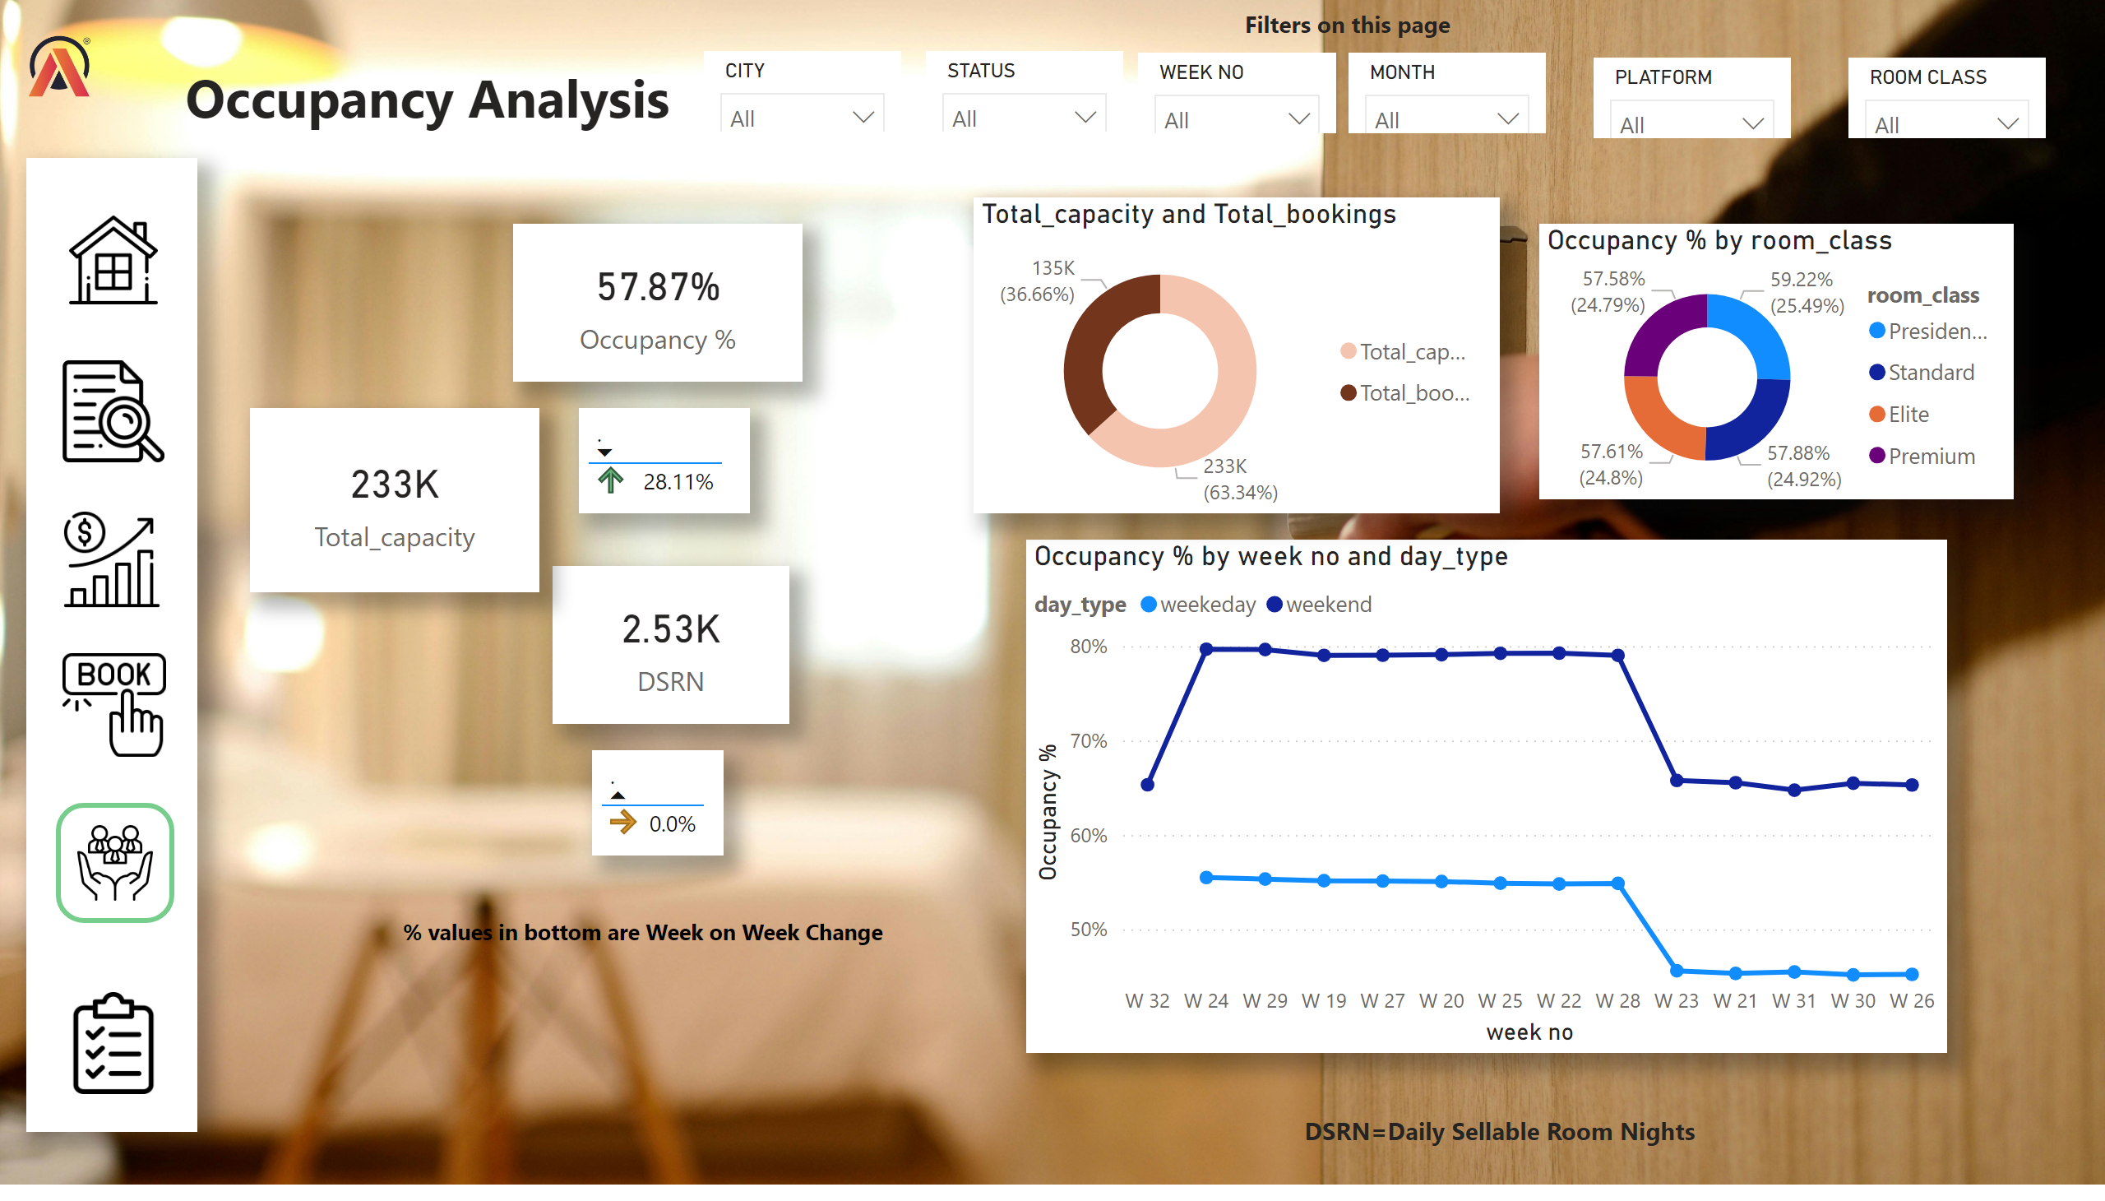
Occupancy Analysis
Notes:
lineChart
No alt text provided
image
No alt text provided
donutChart
No alt text provided
card
No alt text provided
textbox
No alt text provided
textbox
No alt text provided
card
No alt text provided
slicer
No alt text provided
card
No alt text provided
slicer
No alt text provided
slicer
No alt text provided
slicer
No alt text provided
slicer
No alt text provided
slicer
No alt text provided
donutChart
No alt text provided
tableEx
No alt text provided
tableEx
No alt text provided
textbox
No alt text provided
textbox
No alt text provided
shape
No alt text provided
image
No alt text provided
image
No alt text provided
image
No alt text provided
image
No alt text provided
image
No alt text provided
image
No alt text provided

Slide 12
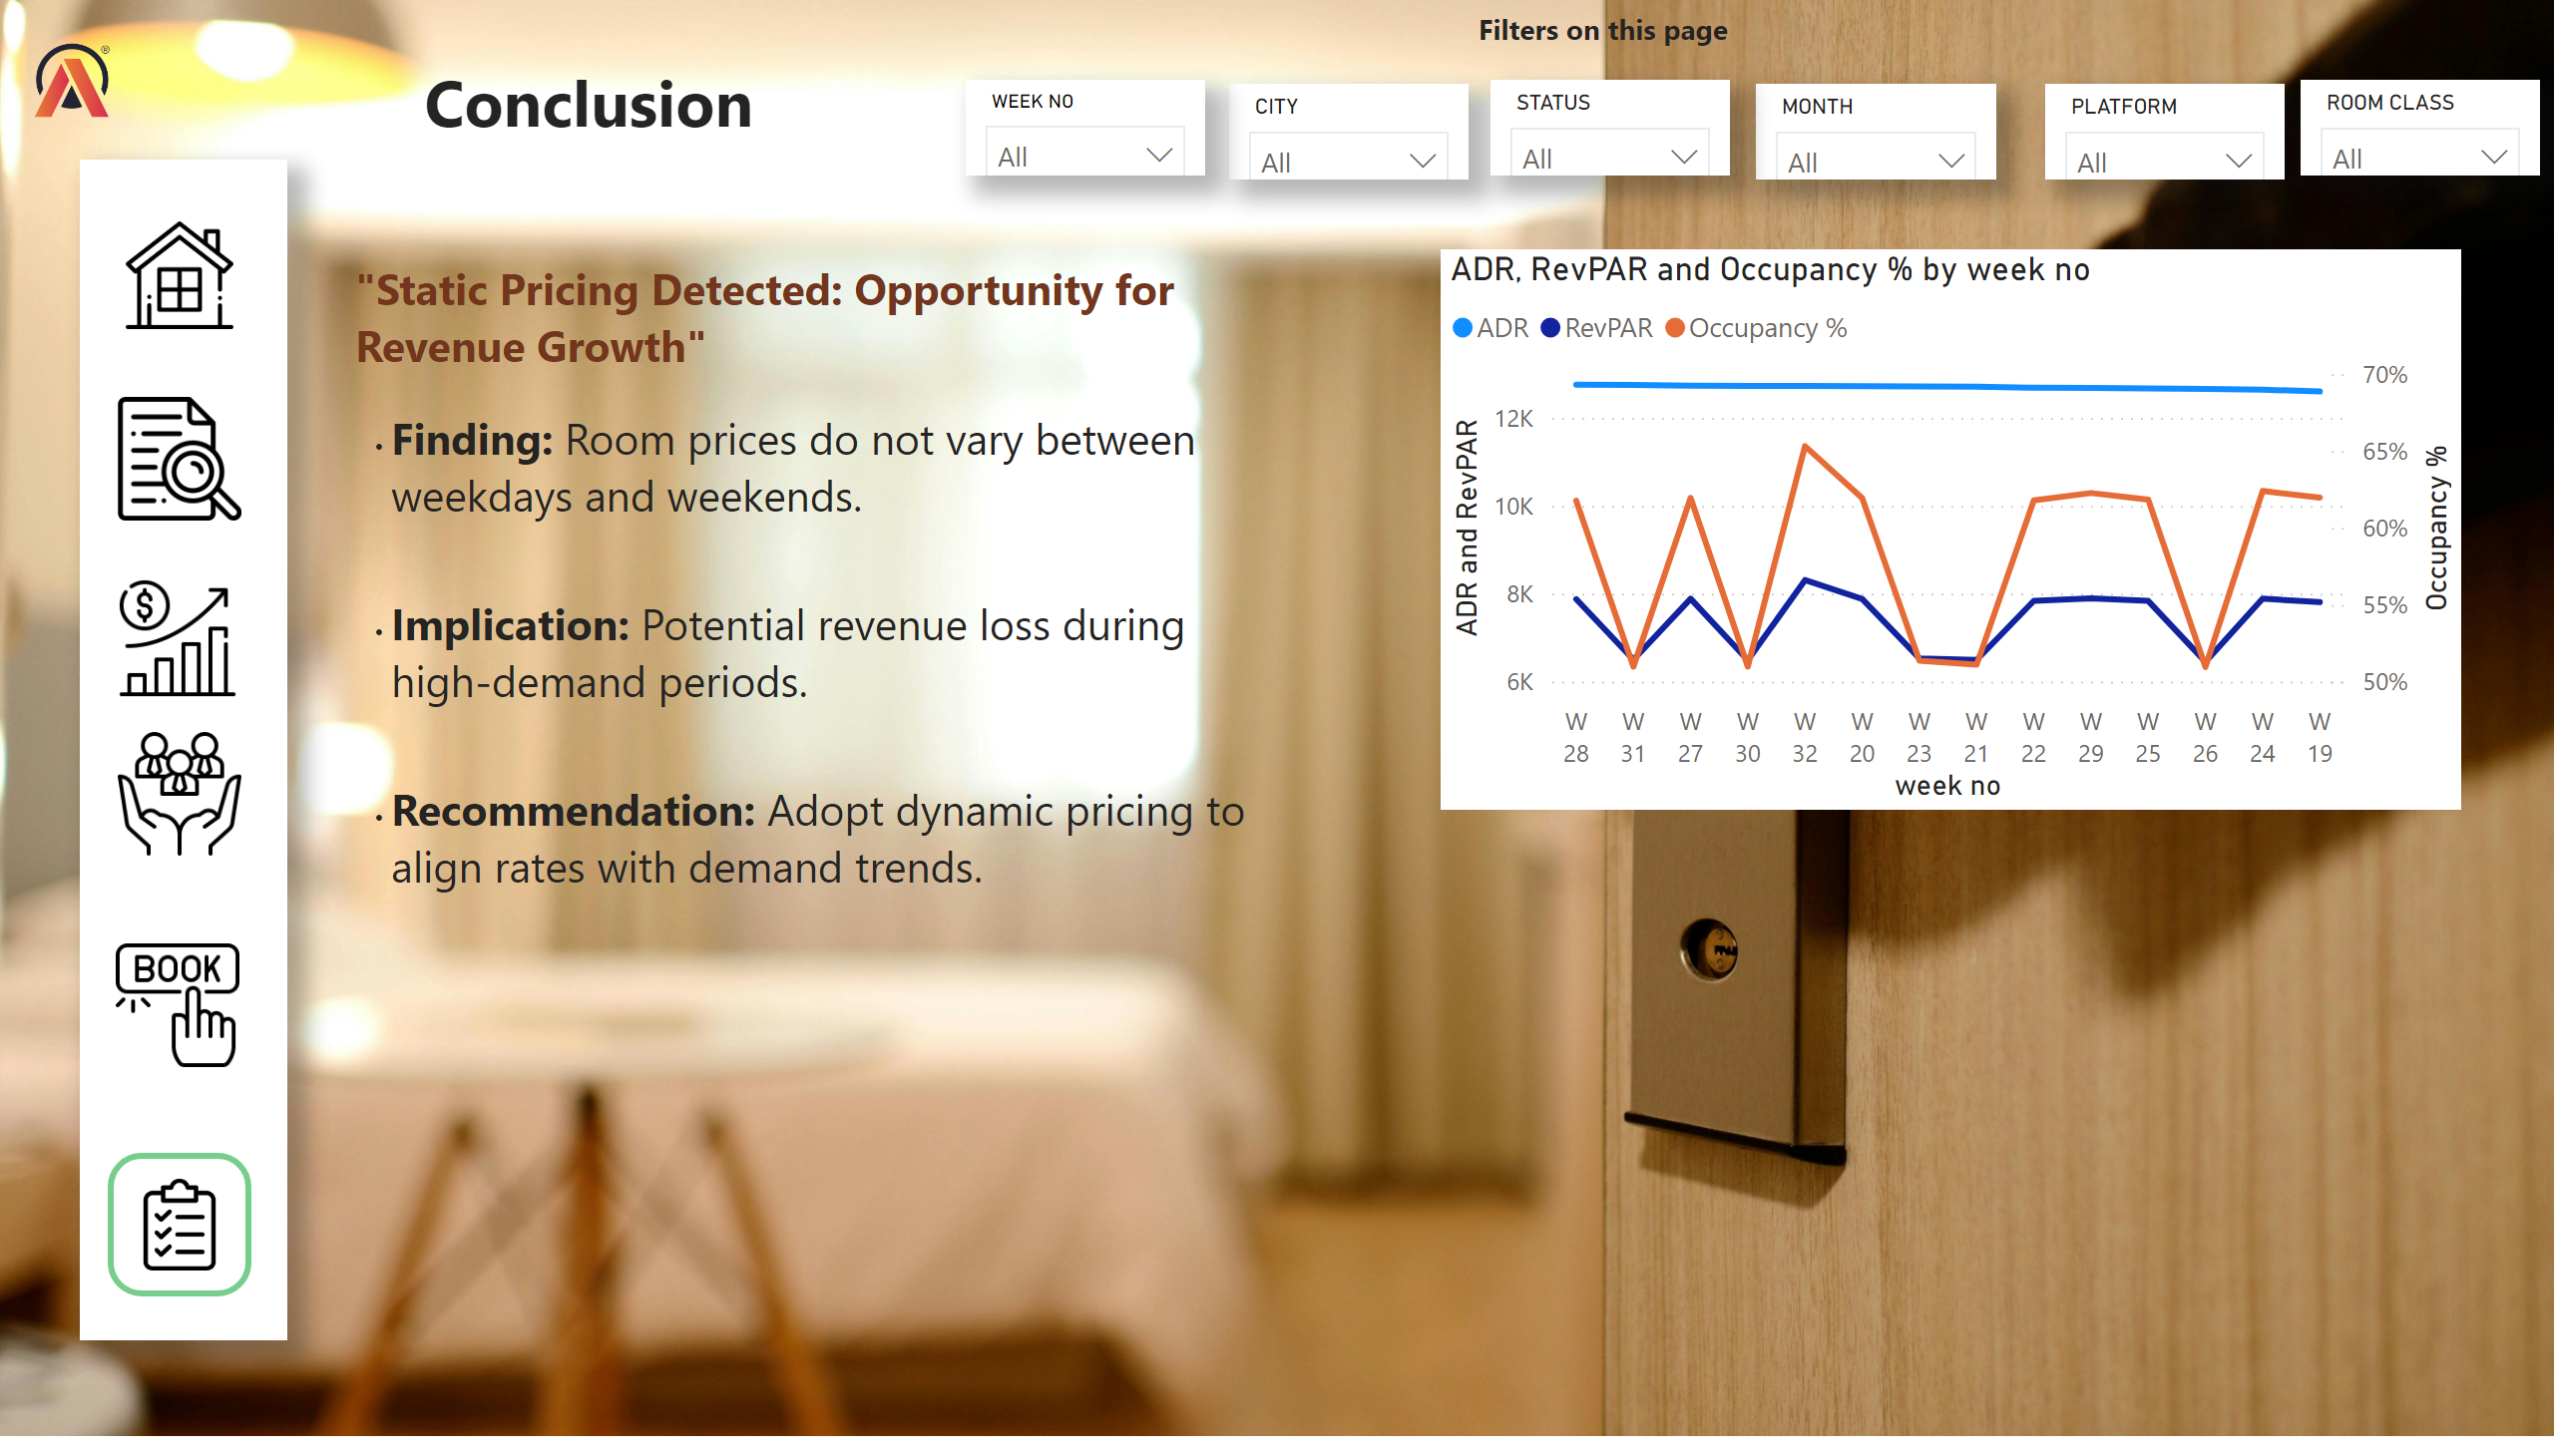
Conclusion
Notes:
shape
No alt text provided
image
No alt text provided
image
No alt text provided
image
No alt text provided
image
No alt text provided
image
No alt text provided
image
No alt text provided
textbox
No alt text provided
image
No alt text provided
lineChart
No alt text provided
slicer
No alt text provided
slicer
No alt text provided
slicer
No alt text provided
slicer
No alt text provided
slicer
No alt text provided
slicer
No alt text provided
textbox
No alt text provided
textbox
No alt text provided

Slide 13
Thankyou

